Slide 1


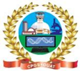
Agri-AI
E Agriculture Management System
Modernizing Agriculture and Empowering Farmers through Technology
Prepared By: Vivekananda Giri
Admission No: 222122114
Guided By: Dr. Jyoti Ranjan Mohanty
Centre For Post Graduate Studies,
Odisha University of Agriculture and Technology, Bhubaneswar
Notes:
Agriculture is the backbone of many economies, and with the advent of technology, there is immense potential to transform this sector. Our project, Agri AI, is designed to leverage AI to provide personalized soil health analysis and crop recommendations. This innovative system offers comprehensive soil testing, real-time status tracking, and intelligent crop selection, aimed at enhancing productivity and sustainability in agriculture.

Slide 2
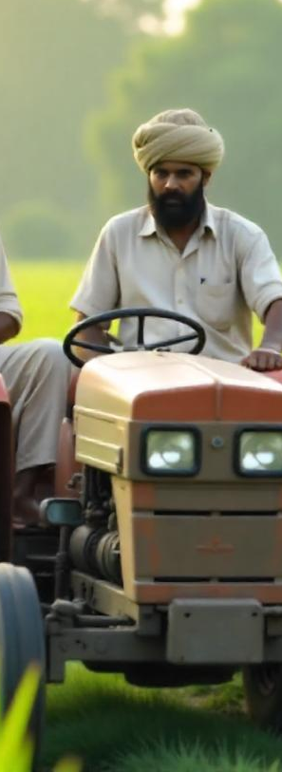
Introduction
The global population is growing, putting immense pressure on food production systems. Farmers face numerous challenges in meeting this demand, including:
Limited access to expertise: Many farmers lack access to agricultural specialists who can diagnose plant problems, recommend optimal growing practices, and advise on efficient resource use.
Lack of real-time data: Farmers often struggle to make informed decisions due to limited access to real-time weather data and soil data and historical agricultural information.
Our project, Agri AI, is designed to leverage AI to provide personalized soil health analysis and crop recommendations. This innovative system offers comprehensive soil testing, real-time status tracking, and intelligent crop selection, and a comprehensive E- Commerce Project aimed at enhancing productivity and sustainability in agriculture.

Slide 3
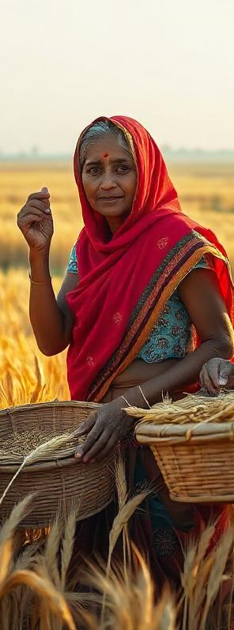
Aim of the Project
To implement a robust ML model to give a correct and accurate real-time prediction of crop in a given state for the particular soil type and climatic conditions.
To provide Fertilizer Suggestion for best suitable crops in the area so that farmers do not incur any loss.
To Provide an E-commerce platform to buy their necessary agricultural goods and Tools.

Slide 4
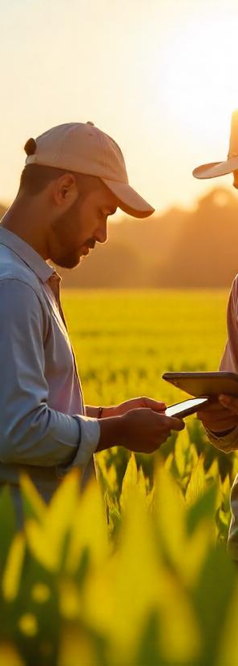
Modules
Farmers Module/User Module: Get Crop Recommendation, Fertilizer Suggestion and E commerce ,Soil test
Admin Module: Manages admin has complete settings of the website and can manage all kinds of records.
Notes:
Key Features:
User Authentication and OTP Verification:
Our system ensures secure access through a robust authentication process, including OTP verification via mobile numbers. This guarantees that only authorized users can access the system, enhancing security and user trust.
User Profile Management:
Users can easily view and update their profiles, ensuring their information is always current. This feature includes functionalities for changing passwords and updating personal details, fostering a personalized user experience.
Soil Test Request and Tracking:
Farmers can request soil tests by filling out an intuitive form that captures essential details such as crop name and nutrient levels. The form is designed with clear labels and validation messages to guide users seamlessly through the process.
Soil Test Report and Visualization:
Once the soil test results are available, users can track their test status and view detailed reports. The results are presented in a tabular format and visualized using bar charts, making complex data easy to understand and analyze.
Crop Recommendation:
Based on the soil test results, our system provides tailored crop recommendations. This helps farmers select the most suitable crops for their soil conditions, thereby optimizing yield and productivity.
Real-Time Data Handling and Alerts:
The system incorporates real-time data handling capabilities, sending alerts and notifications to users about their soil test status and recommendations. This ensures timely updates and proactive decision-making.

Slide 5









Technologies Used
Front End Technology: (HTML, CSS, JavaScript, Bootstrap)
Programming Language: (Python)
Database: (My SQL)
Frameworks: (Django)
Machine learning Model: (Random Forest, Logistic Regression, Decision Trees etc.)
Data science libraries: (Pandas, NumPy, ScikKit-learn, Seaborn, Joblib etc.)
OTP Sender Tool: Twillio

Slide 6
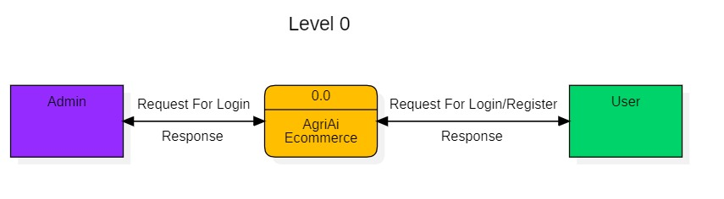

Data Flow Diagram(Level-0)

Slide 7
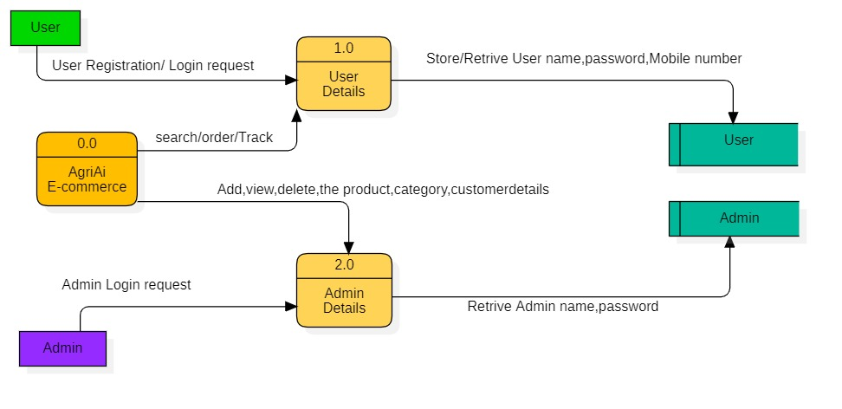
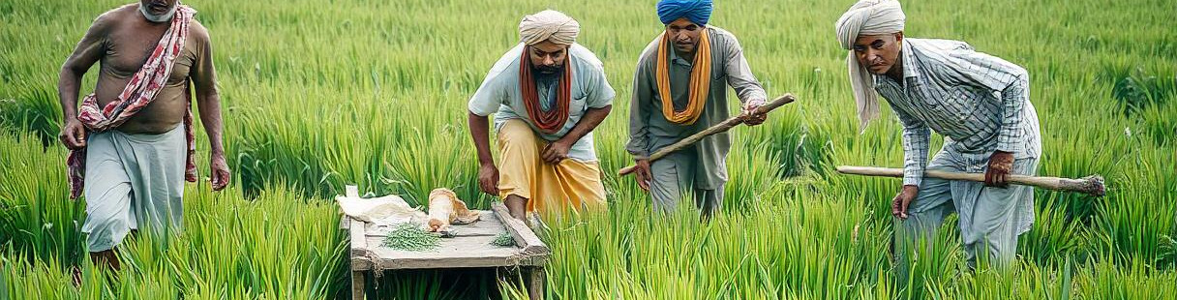
Data Flow Diagram(Level-1)

Slide 8
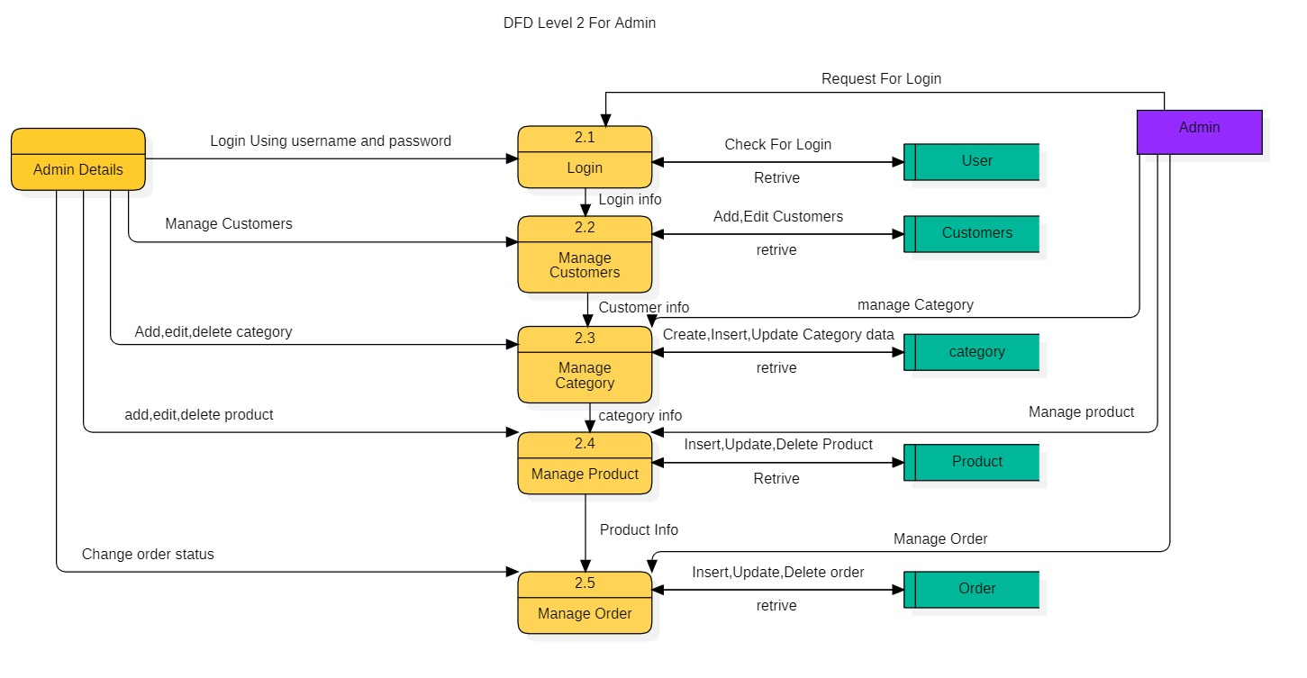
Data Flow Diagram(Level-2)
2.0

Slide 9
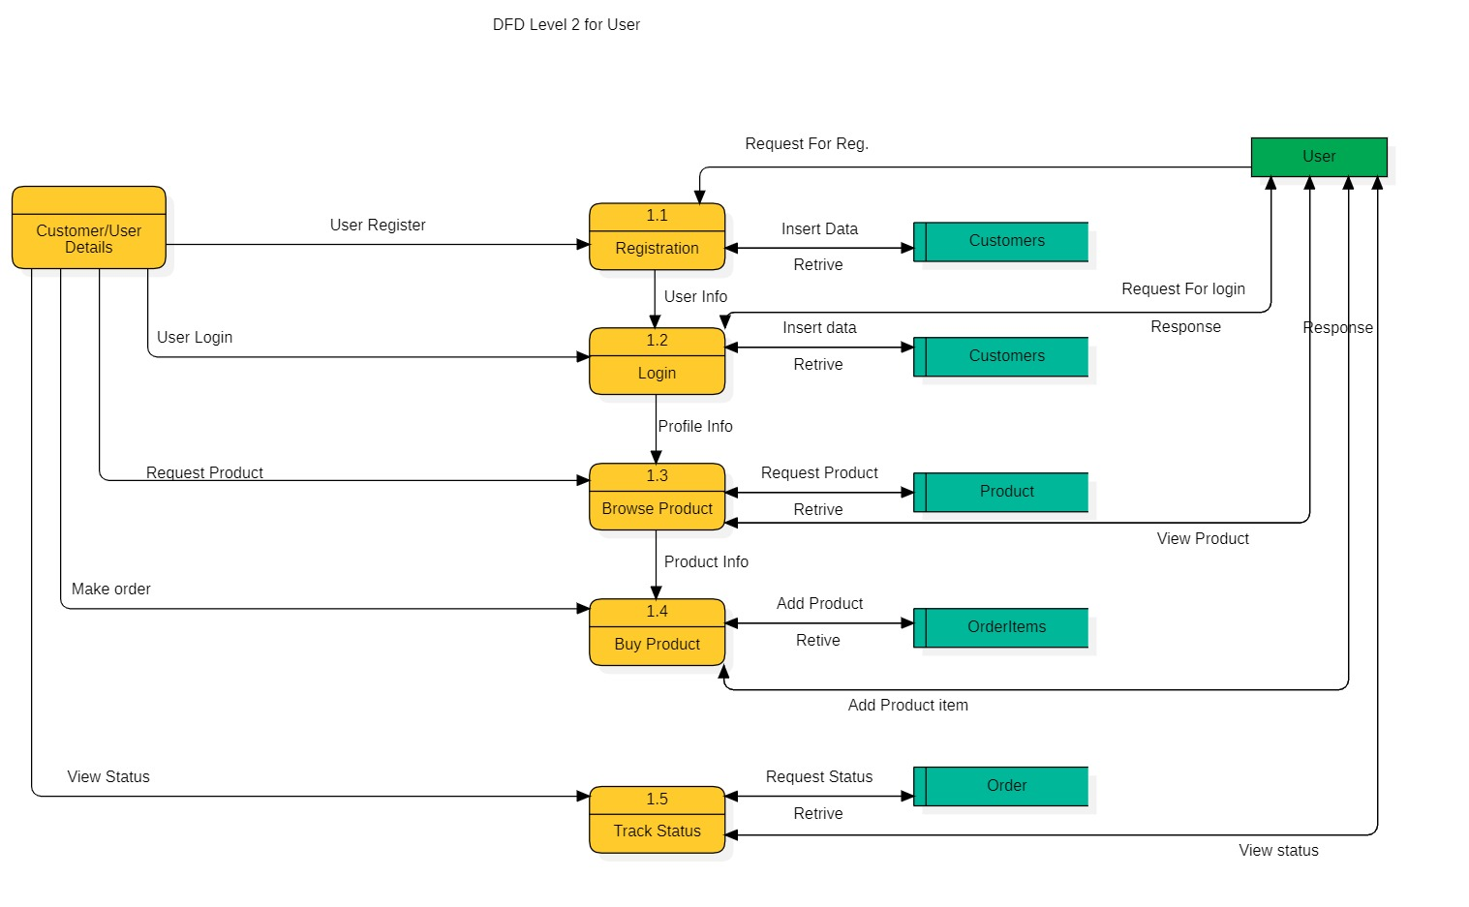
Data Flow Diagram(Level-2)
1.0

Slide 10
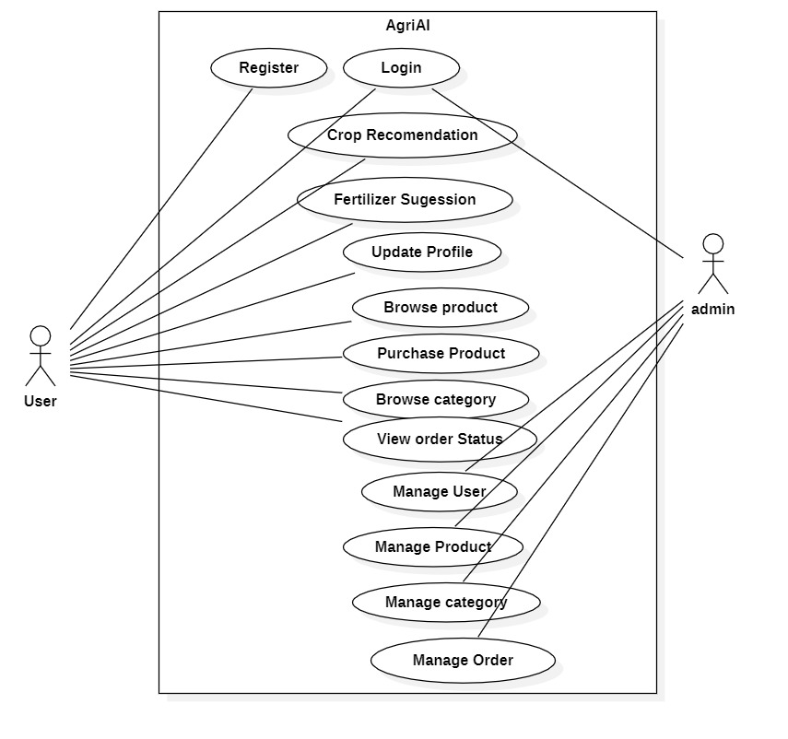
Use Case Diagram

Slide 11
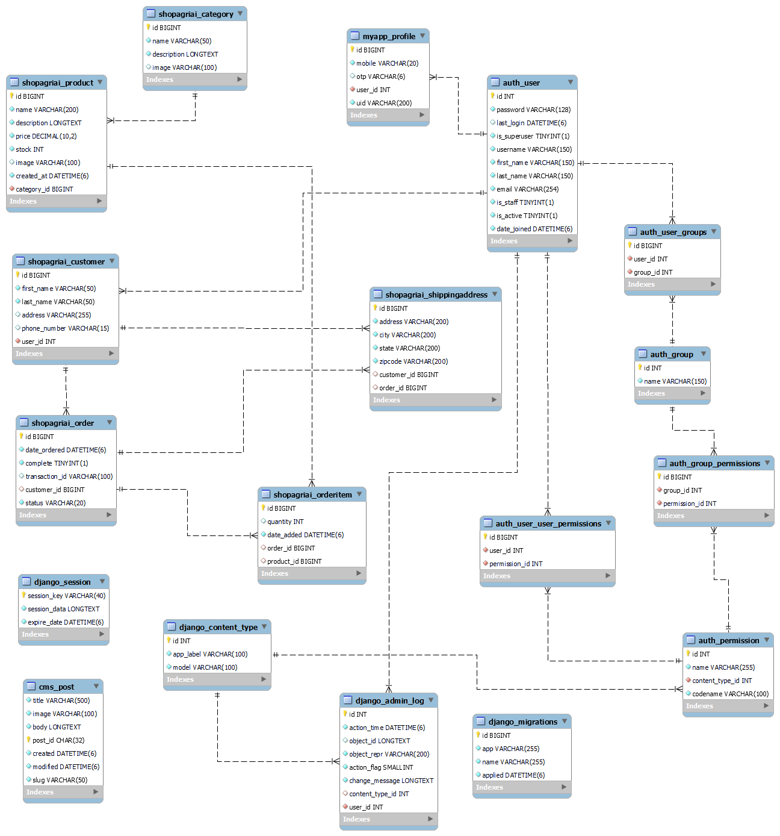
Database Schema

Slide 12
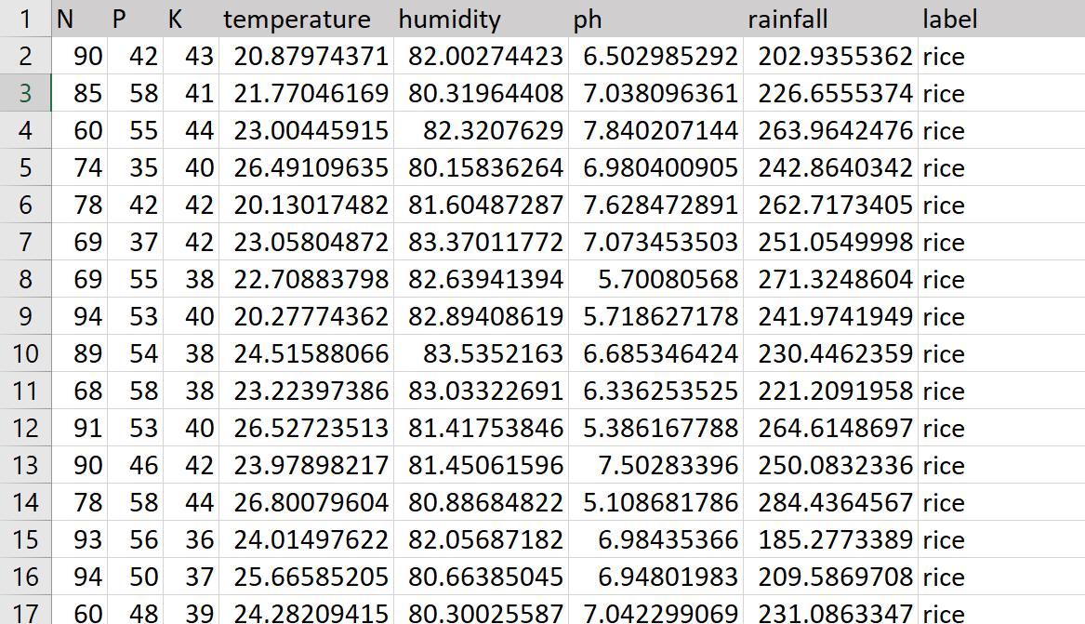
Dataset Used For Crop Recommendation

Slide 13
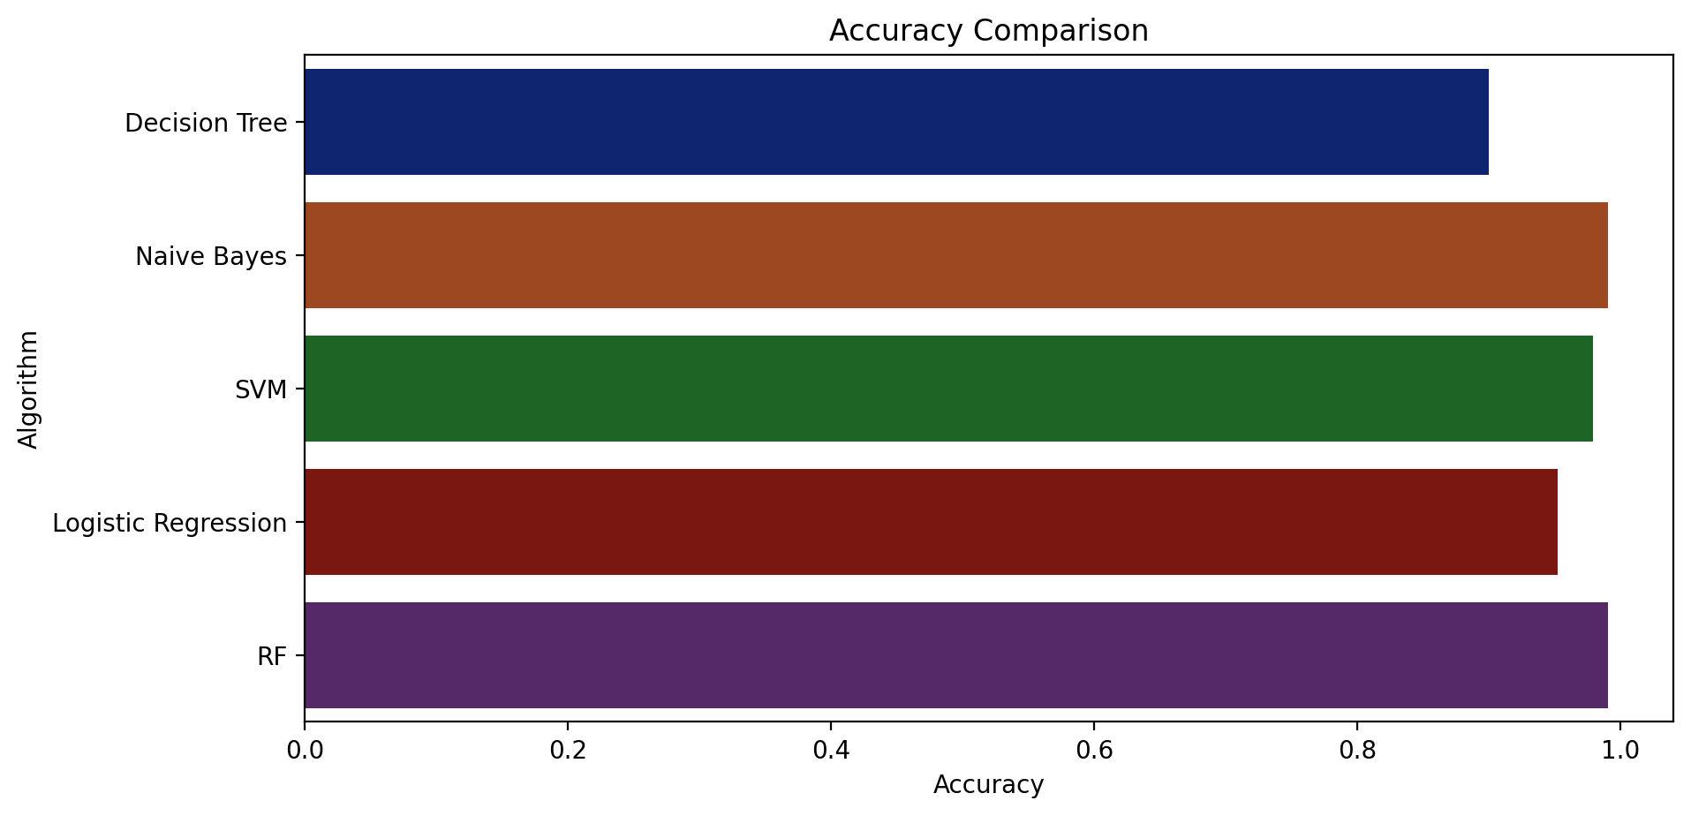
Algorithm Comparison

Slide 14
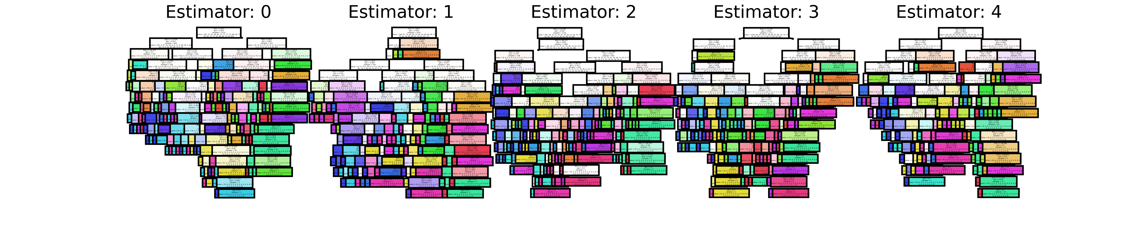
Random Forest Visualisation

Slide 15
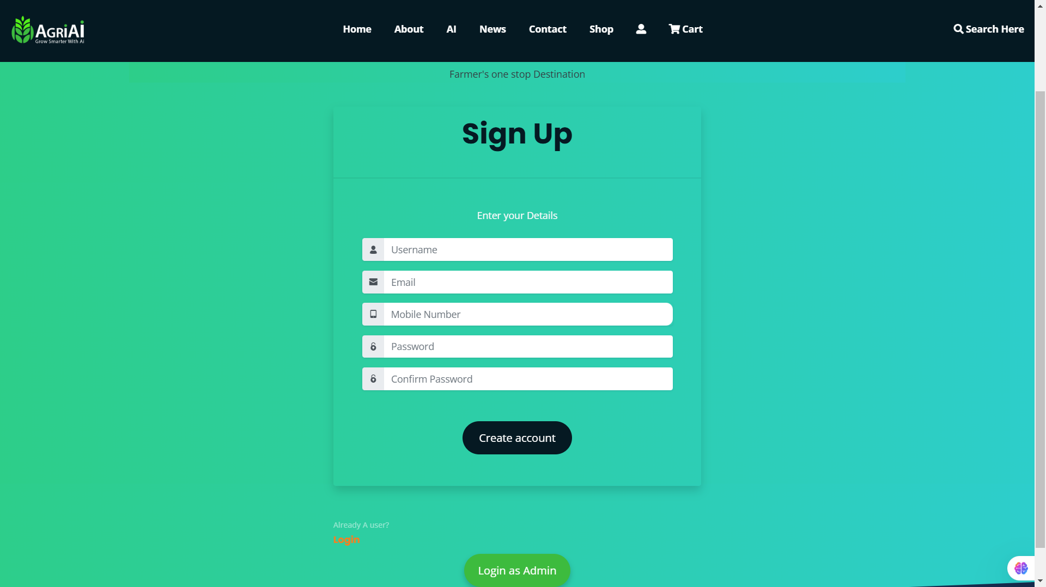
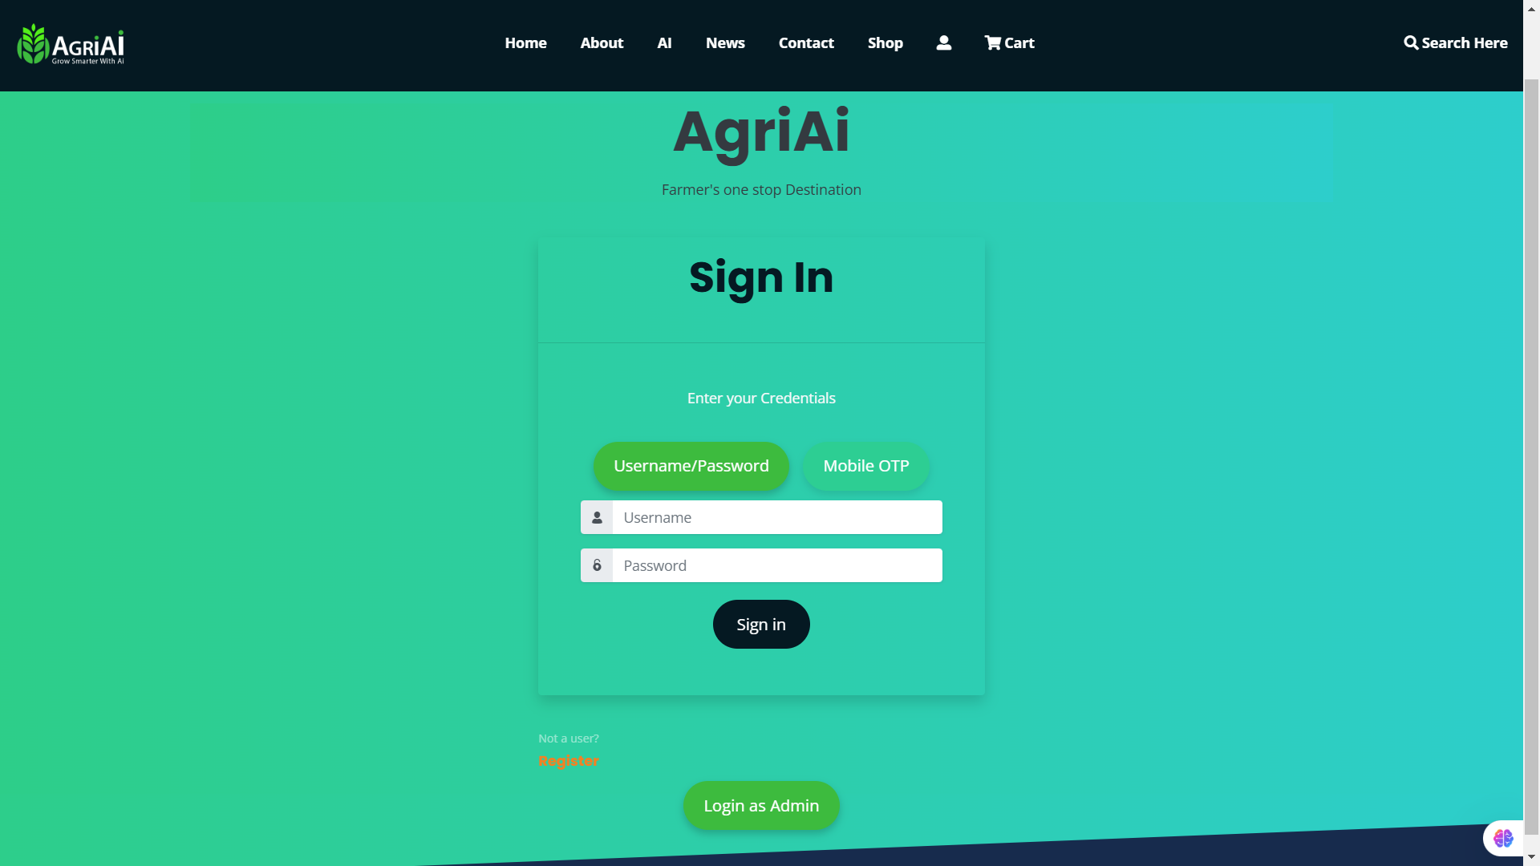
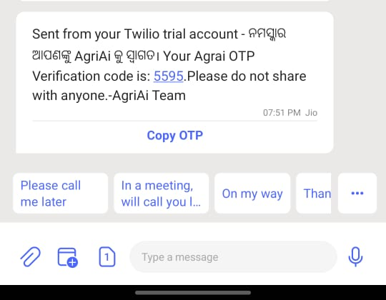
Snapshot

Slide 16
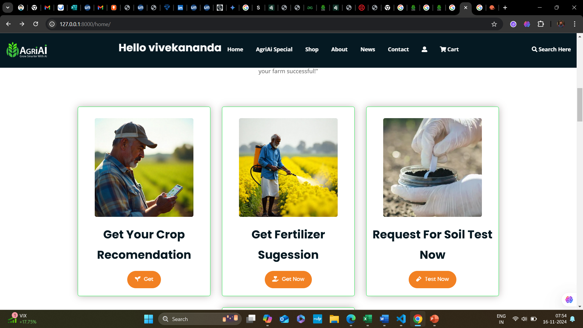
Snapshot

Slide 17
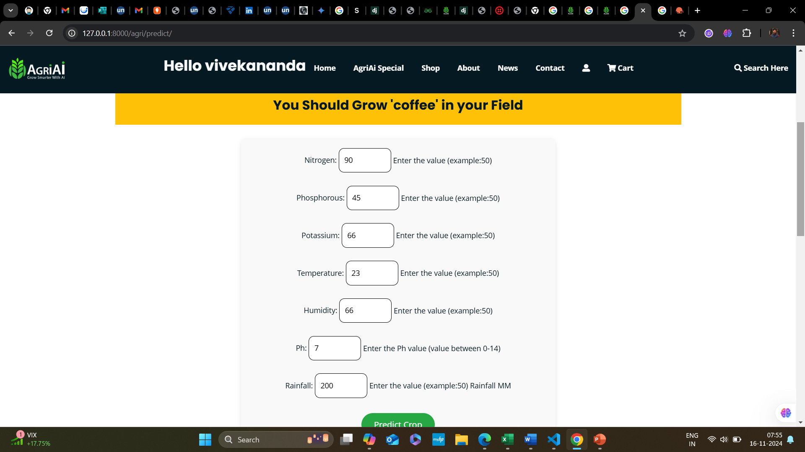
Snapshot

Slide 18
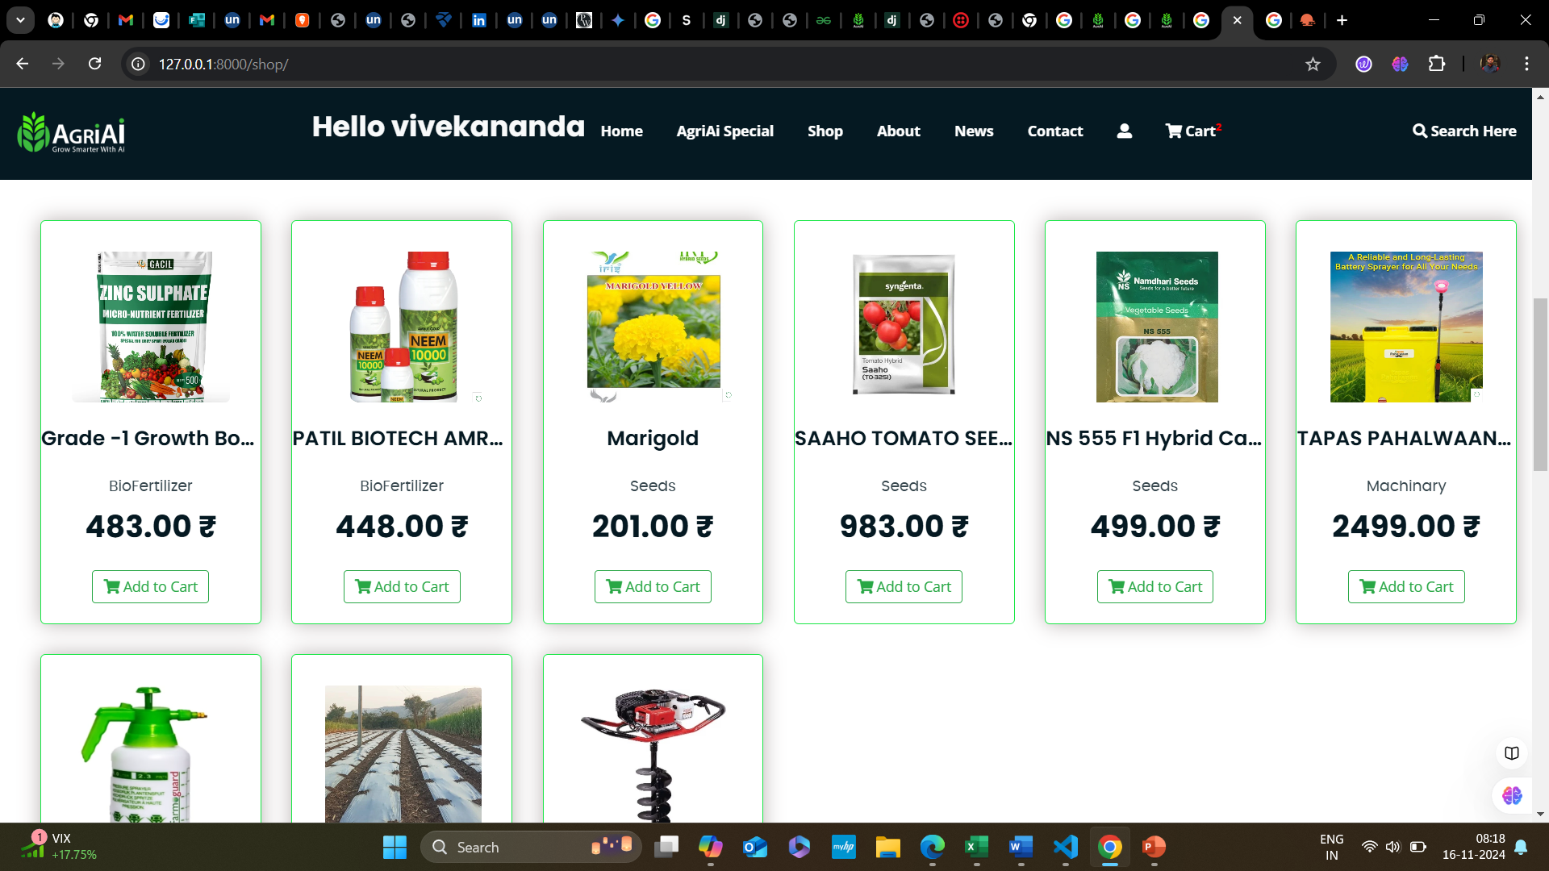
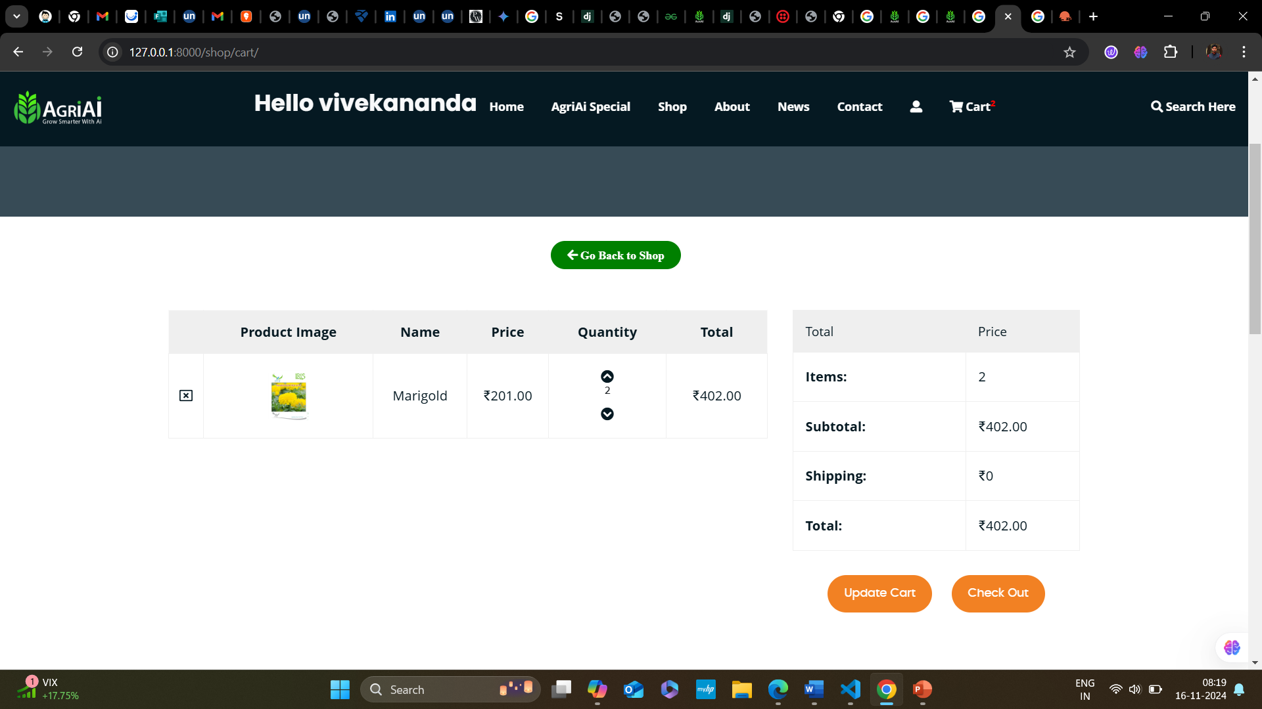
Snapshot

Slide 19
Future Scope
1.Advanced AI and Machine Learning
Predictive Analytics:
Enhanced Personalization:
2. IoT Integration
Real-Time Monitoring:
Automated Irrigation Systems:
4. User Experience Enhancements
Mobile Application:
Multilingual Support:
5. Community and Social Features
Expert Consultations:
6. Data Analytics and Reporting
Advanced Analytics Dashboard:

Slide 20
Thank you
Centre For Post Graduate Studies,
Odisha University of Agriculture and Technology, Bhubaneswar

